Slide 1
RAG DS-17 2024 Guy Yarhi

Slide 2
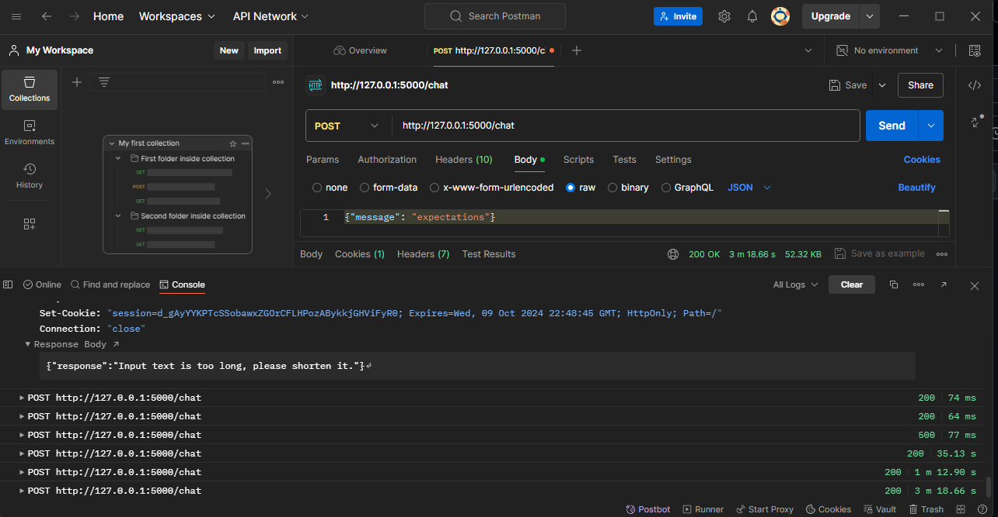
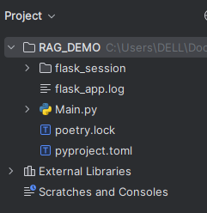
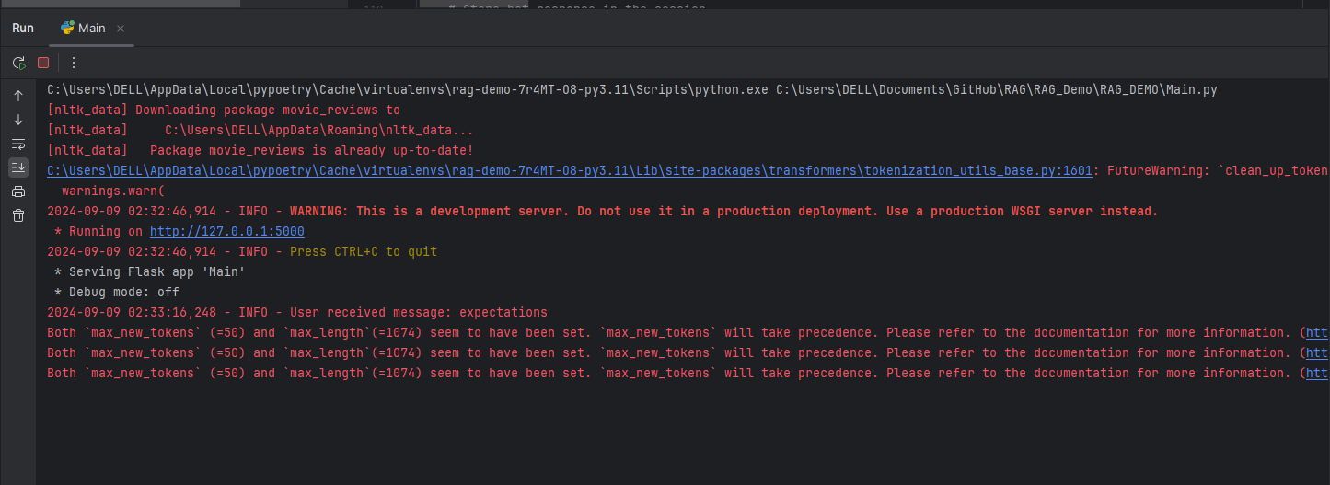

Slide 3
Introduction
Title: Introduction to Retrieval-Augmented Generation (RAG) System
Overview:
What is a RAG System?
Purpose and applications.
Components:
Retrieval Mechanism
Generation Model
Objective:
To enhance text generation by integrating external knowledge retrieval.
Image: TBD
Simple diagram showing the high-level flow of RAG: User Input → Retrieval → Generation → Output.
Hyperlink to RAG

Slide 4
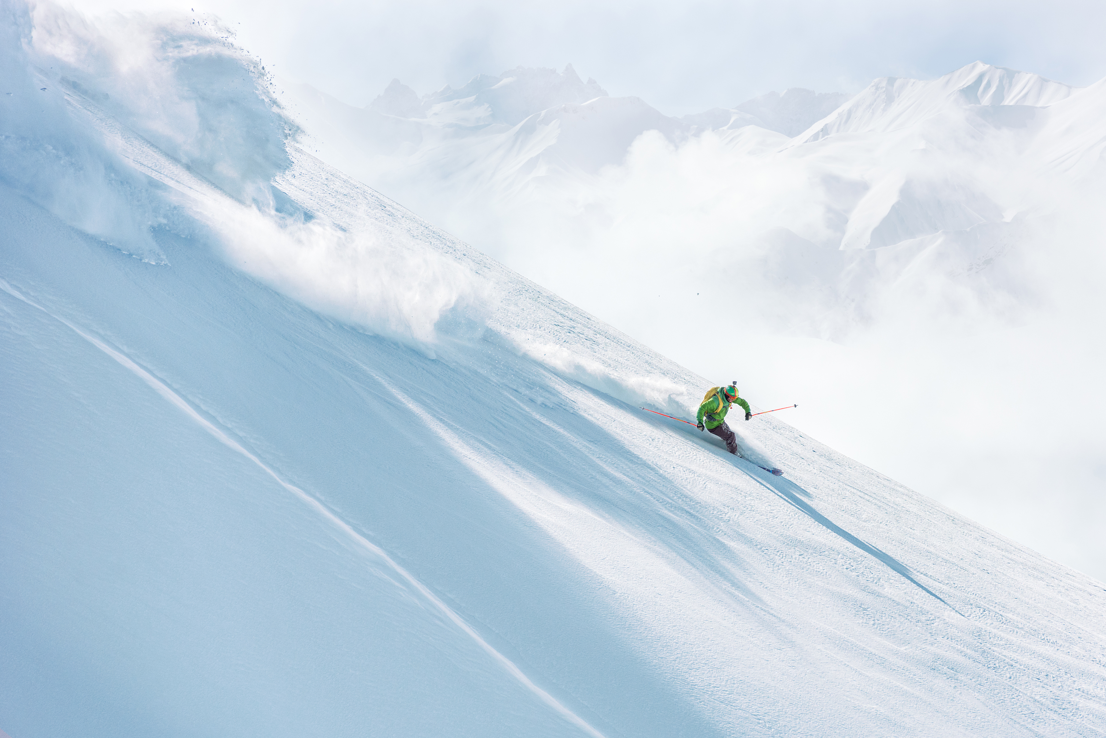
Components: Data Source: Document Database Retrieval Mechanism: Embedding Generation, Similarity Search Generation Model: GPT-2 Model Interaction Layer: Flask Application Workflow: Data Ingestion → Embedding Creation → Query Handling → Response Generation Image: TBD A clear architecture diagram showing the interaction between the components: Document Database, Retrieval Mechanism, Generation Model, and Flask Application.
System Architecture of the RAG System

Slide 5
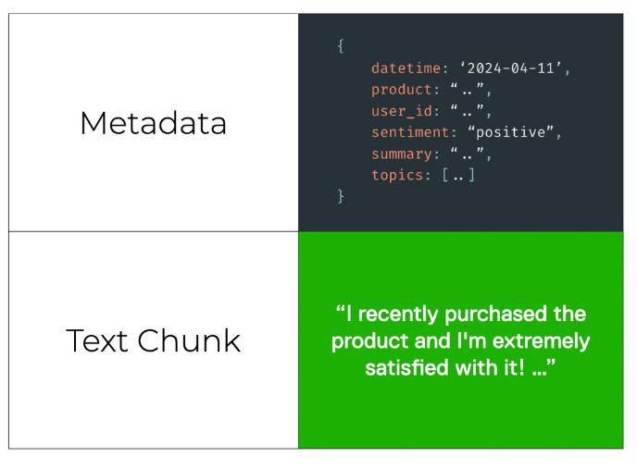
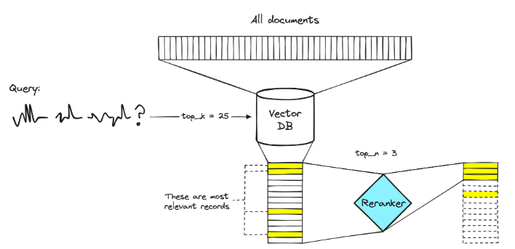
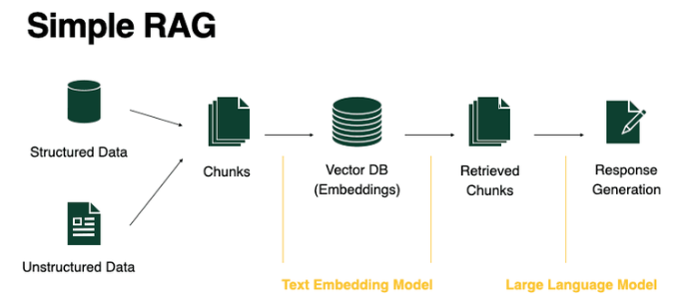
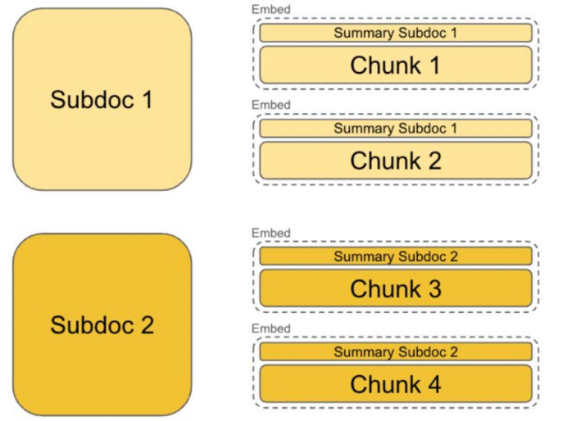
System Architecture of the RAG System

Slide 6

Data Diagram
Confidence-building strategy
Data Sources: NLTK Movie Reviews Dataset Data Structures: Document Embeddings Document Database User Queries and Responses Image: Data diagram showing: Raw Documents Processed Embeddings Document Database Query Embeddings and Responseses

Slide 7
Data Diagram and Storage
Steps:
1. Data Loading: Read and preprocess text data.
2. Training Word2Vec Model: Create document embeddings.
3. Query Handling: Generate embeddings for user queries.
4. Document Retrieval: Find relevant documents using similarity search.
5. Response Generation: Create responses using the GPT-2 model.
Image: Flowchart illustrating the data flow from initial document loading to response generation.

Slide 8
Summary of Important Functionalities:
Data Download and Loading:
download_imdb_data(url): Downloads and loads a TSV file from IMDb into a pandas DataFrame.
retrieve_imdb_data_and_compare(): Retrieves and filters IMDb TV show data (2020-2023), compares it with NLTK movie reviews,
and prepares a list of titles for further use.
Preprocessing:
Tokenizes documents by removing punctuation and converting to lowercase.
Word2Vec Model Training:
Trains a Word2Vec model on the tokenized documents.
Document Embeddings:
Generates embeddings for each document using the Word2Vec model. Handles documents with no valid words by assigning a zero vector.
Vector Database:
Creates a dictionary to map document indices to their content.
Logging:
Configures logging to record application events.
Flask Application Initialization:
Sets up a Flask web application with session management.
Text Generation:
Initializes GPT-2 tokenizer and model.
Generates text in chunks to handle long input sequences.
Query Handling:
get_embedding(query_text): Computes the embedding for a query.
generate_text_in_chunks(input_text, model, tokenizer, max_length): Generates text in chunks using GPT-2.
Web API Endpoint:
/chat: Handles POST requests to generate responses based on user input, retrieves relevant documents, computes similarity, and generates text.

Slide 9
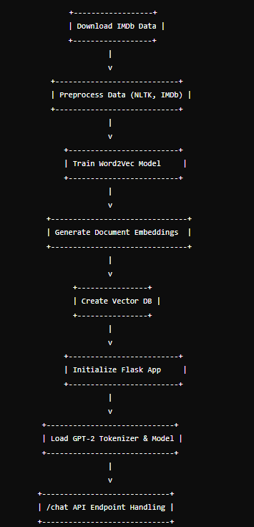
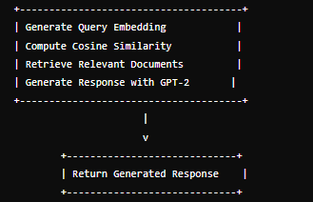
Flow Diagram

Slide 10
Data Diagram
Structures: Document Embeddings Document Database User Queries and Responses Image: Data diagram showing: Raw Documents Processed Embeddings Document Database Query Embeddings and Responseses

Slide 11
Query and Document Embeddings
Purpose:
Transform text data into numerical vectors.
Process:
Word2Vec Model Training
Document Embedding Generation
Query Embedding Generation
Tools Used:
Gensim Word2Vec
NumPy for Calculations
Image: Diagram showing:
Text Data → Word Embeddings → Document Embeddings
User Query → Query Embeddings

Slide 12
Data Diagram
Structures: Document Embeddings Document Database User Queries and Responses
Image:
Data diagram showing: Raw Documents Processed Embeddings Document Database Query Embeddings and Responseses

Slide 13
Interaction with Flask
Title: Interaction with Flask
Overview:
Flask Application Setup
Handling User Input
Generating Responses
Session Management:
Store conversation history
Manage state across requests
Image: Interaction diagram showing:
User Input → Flask App → Query Processing → Response Generation → User Output

Slide 14
Summary
Summary:
Recap of system components and workflow.
Future Enhancements:
Metadata filtering
Reranking models
Model fine-tuning
Scaling and performance improvements
Additional features and integrations
Image:TBD
High-level summary diagram or bullet points summarizing key points.

Slide 15
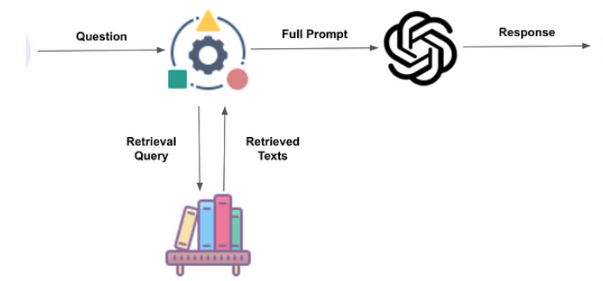
Thank you
Guy Yarhi

